Slide 1
Covid recovery opportunities
China
Presented by: Ahmed Radwan

Slide 2
Agenda
Market Situation
Opportunities
Price/Pack Mix
Assortment Shifts
Rural Emergence
Demand Shifts

Slide 3




Executive Summary
Situation:
CoVID-19 Pandemic has immensely changed the market and the consumers with different impact across categories
Complication:
Client Categories having stagnant growth
Business Question:
What are the growth opportunities for Client in YTD 2021?
Answers:
Omni-channel
Existing Economic Packs
Economic Alternatives (Adjacent Categories)
Large Cities Promotions
Assortment Optimization
Promising NPDs
Gifting Packages
IP or Other Brand Cooperation
New Consumer Trends Untapped in Snacks
Source: flaticon.com, dreamstime.com, freeicon.com, uxwing.com

Slide 4
Market Situation

Slide 5
CAPTURE GROWTH IN EMERGING CHANNELS
Offline recovering whereas Online is slowing down; Omnichannel is growing faster
NAT | Value % CHG vs LY
0%
0%
0%
Data source: Nielsen RMS data, Cross Category ending Aug’20, Omnipanel ending W30

Slide 6




REVIVE AND DEVELOP YOUR CATEGORIES
FC and Chocolates recovered while Gum and Mints have stabilized at a new lower level
Total Categories | NAT | Sales Value
Gum
FC
Nov
Sep
Nov
Sep
Mints
Chocolates
Nov
Sep
Nov
Sep
Data source: Nielsen RMS data, Data ending Sep’20

Slide 7
Opportunities

Slide 8




CURRENT MARKET TRENDS
PRICE/PACK MIX
ASSORTMENT SHIFTS
RURAL EMERGENCE
DEMAND SHIFTS
ECONOMY PACKS
PROMOTIONS
ECONOMIC ALTERNATIVES
SHRINKING SHELF SPACE
SOFTENING CORE
POTENTIAL NPDS
RURAL FASTER RECOVERY vs URBAN
EMERGING SNACKS SEGMENTS
ADJACENT CATEGORIES TRENDS

Slide 9
CURRENT MARKET TRENDS
PRICE/PACK MIX
ASSORTMENT SHIFTS
RURAL EMERGENCE
DEMAND SHIFTS
ECONOMY PACKS
PROMOTIONS
ECONOMIC ALTERNATIVES
SHRINKING SHELF SPACE
SOFTENING CORE
POTENTIAL NPDS
RURAL FASTER RECOVERY vs URBAN
EMERGING SNACKS SEGMENTS
ADJACENT CATEGORIES TRENDS

Slide 10
FOCUS ON MORE ECONOMIC PACKS
Price/Pack
Assortment
Rural Emergence
Demand Shifts
Shift to more economic and mainstream packs across FMCG and client categories
Value Share | NAT
FMCG
Gum
Mints
FC
Chocolates
Data source: Nielsen RMS data, Data ending Sep’20
Data source: Webinar 3.0: Nielsen Retail Measurement Offline; Value Share; Representative Basket: Breakfast Cereal, Crispy Snack, Liquid Milk, Packaged Water, Soy Sauce, Biscuit, Antiseptic Liquid, Dish Washing, Laundry Detergent, Personal Wash, Shampoo, Toothpaste; Economy: PI<90; Mainstream: 90<=PI<110; Premium:110<=PI<150; Super Premium: PI>=150

Slide 11
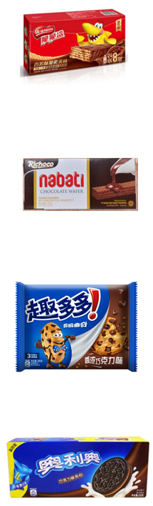
Price/Pack
Assortment
Rural Emergence
Demand Shifts
OFFER MORE ECONOMIC ALTERNATIVES
More economic alternatives available through adjacent categories
NAT
MAT2006 | Value Share | GR
Biscuit |  | -ve
Chocolate Biscuits | ~20% | +ve
By Chocolate Biscuits Sub-segment | Price Index vs. total biscuit | Price/kg
Sandwich | 85% | 52.5
Specialties | 140% | 85.4
Cookie | 100% | 61.5
Wafer | 90% | 52.7
Chocolate total | 300% | 141.7
Top Performers
Corp. Nestle CCS 32*20g
Price/Pack: 29.9RMB
Nababi Richoco 145g
Price/Pack: 6.4RMB
Mondelez Chips Ahoy 95g*3
Price/Pack:14.0RMB
Oreo Sandwich 233g
Price/Pack:12.0RMB
Data source: Nielsen RMS data, Data ending Sep’20

Slide 12
Price/Pack
Assortment
Rural Emergence
Demand Shifts
PROMOTE IN BIG CITIES MT TO BOOST SHARE
Long term price reductions in Key MT cities with Enormous share gain
Competition Hero Pack| Price per KG vs LY
Competition Hero Pack | +/- Value Share vs LY
0%
Data source: Nielsen RMS data, Data ending Sep’20; Webinar 3.0

Slide 13
CURRENT MARKET TRENDS
PRICE/PACK MIX
ASSORTMENT SHIFTS
RURAL EMERGENCE
DEMAND SHIFTS
ECONOMY PACKS
PROMOTIONS
ECONOMIC ALTERNATIVES
SHRINKING SHELF SPACE
SOFTENING CORE
POTENTIAL NPDS
RURAL FASTER RECOVERY vs URBAN
EMERGING SNACKS SEGMENTS
ADJACENT CATEGORIES TRENDS

Slide 14
Price/Pack
Assortment
Rural Emergence
Demand Shifts
SHARPEN ASSORTMENT TO FIT SHELF SPACE
Categories Penetration has not decreased severely yet Assortment is highly impacted
-15% | +15%
-30% | +30%
ND TDP vs LY Sep'20 | Gum | Mints | FC | Pack Chocolates
NAT
Hyper
Super
Mini
CVS
TT
SKU per Handler | Hyper | Super | Mini | CVS
YTD 2007
FMCG
Impulse
Contributing Manufacturers/
Brands:
Extra
DMG
5
MDLZ
MW Mints
MW FC
AO
Dove
Snickers
CXM
AO
Data source: Nielsen RMS data, Data ending Sep’20; Webinar 3.0

Slide 15
Price/Pack
Assortment
Rural Emergence
Demand Shifts
SHARPEN CORE TO REVIVE SHARE
Core SKUs driving decline across categories except Chocolates
Client| +/- Value Share vs LY | NAT
Gum
FC
Mints
Chocolates
Data source: Nielsen RMS data, Data ending Sep’20

Slide 16


Price/Pack
Assortment
Rural Emergence
Demand Shifts
COUNTER FOR EXPANDING COMPETITION
Competition is expanding with its hero pack across all MBDs while deprioritizing other packs
ND/ND TDP | NAT
Competition Brand | Sep’20 vs May’20
 | ND +/- | Val Share +/-
NAT |  | +ve
Hyper | 0 | +ve
Super |  | +ve
Mini |  | +ve
CVS |  | +ve
TT |  | +ve
 | ND +/- | Val Share +/-
Key Urban |  | +ve
A Urban |  | +ve
B Urban |  | +ve
C Urban |  | +ve
D Urban |  | +ve
Rural |  | +ve
+ New Flavors
+ New Flavors
+ New Flavors
East |  | +ve
South |  | +ve
West |  | +ve
North |  | +ve
East Urban |  | +ve
South Urban |  | +ve
West Urban |  | +ve
North Urban |  | +ve
East Rural |  | -ve
South Rural |  | +ve
West Rural |  | +ve
North Rural |  | +ve
Data source: Nielsen RMS data, Data ending Sep’20

Slide 17
Price/Pack
Assortment
Rural Emergence
Demand Shifts
Assortment Analysis
SKUs are classified into 4 types depending on their distribution and consumer pull vs avg of market
Distribution
Weakening Core
Blockbusters/Hero SKUs
Avg of market SKUs
Consumer Pull
Lame Duck
Sleeping Beauty
Data source: Nielsen RMS data, Data ending Sep’20; Webinar 3.0

Slide 18
Price/Pack
Assortment
Rural Emergence
Demand Shifts
PUSH CORE DISTRIBUTION IN URBAN
Huge opportunity for Core enhancement in Urban Areas
Number of SKUs | Additional Sales value (‘000RMB) | YTD TY
Gum
FC
Pushing distribution of SB SKUs to lowest BB SKU
Pushing distribution of BB SKUs to highest BB SKU
~ +55Mn RMB
~ +150Mn RMB
Mints
Chocolates
Pushing distribution of BB SKUs to highest BB SKU
Pushing distribution of SB SKUs to lowest BB SKU
~ +200Mn RMB
~ +260Mn RMB
Data source: Nielsen RMS data, Data ending Sep’20; Webinar 3.0

Slide 19
Price/Pack
Assortment
Rural Emergence
Demand Shifts
NURTURE POTENTIAL NPDS
Promising NPDs with high sales potential yet still low distribution level
Max WD | Sep’20
Pushing distribution of FC NPD to Hero SKU level in MT would yield ~28.5 Mn RMB for YTD
Pushing distribution of top 4 NPDs to Chocolates Hero SKU level in Hyper and Super would yield ~32.4 Mn RMB for YTD
Data source: Nielsen RMS data, Data ending Sep’20

Slide 20
CURRENT MARKET TRENDS
PRICE/PACK MIX
ASSORTMENT SHIFTS
RURAL EMERGENCE
DEMAND SHIFTS
ECONOMY PACKS
PROMOTIONS
ECONOMIC ALTERNATIVES
SHRINKING SHELF SPACE
SOFTENING CORE
POTENTIAL NPDS
RURAL FASTER RECOVERY vs URBAN
EMERGING SNACKS SEGMENTS
ADJACENT CATEGORIES TRENDS

Slide 21


Price/Pack
Assortment
Rural Emergence
Demand Shifts
SEIZE THE ONGOING GROWTH IN RURAL
High potential of Rural areas for consumption
CCI (Apr’20)
FMCG | YTD 2007
Job Prospects:
Rural: 62 vs 55 NAT
Value % CHG vs LY
Time to Spend:
Rural: 47 vs 44 NAT
Value Importance
~20% | ~20% | ~10% | ~10% | ~40%
Data source: Nielsen RMS data, Data ending Sep’20; CCI study

Slide 22
Price/Pack
Assortment
Rural Emergence
Demand Shifts
BE VISIBLE IN RURAL WITH FOCUSED SKUs
Distribution plays a more important role in Rural vs Urban with more stores, less productivity per store yet faster growth
YTD 2009 | Gum |  | Mints |  | FC |  | Pack Chocolates
 | Rural | vs Urban | Rural | vs Urban | Rural | vs Urban | Rural | vs Urban
Importance to Category | ~40% |  | ~25% |  | ~40% |  | ~25%
Handlers (Mn Stores) | 2.5 |  | 0.8 |  | 2.3 |  | 1.5
Store Productivity (RMB/Store) | ~1,500 |  | ~600 |  | ~1,200 |  | ~1,400
Value % Growth vs LY
SKU per Handler
High Rural Importance
Much more stores number
Less Store Productivity
Faster growth
More focused portfolio needed
Data source: Nielsen RMS data, Data ending Sep’20

Slide 23
Price/Pack
Assortment
Rural Emergence
Demand Shifts
EXPAND YOUR HEROES IN RURAL
Highest opportunity for Gum in Rural
Number of SKUs | YTD TY
Gum
FC
Pushing distribution of BB SKUs to highest BB SKU
Pushing distribution of BB SKUs to highest BB SKU
~ +1bn RMB
~ +80Mn RMB
Mints
Chocolates
Pushing distribution of BB SKUs to highest BB SKU
Pushing distribution of SB SKUs to lowest BB SKU
~ +35Mn RMB
~ +30Mn RMB
Data source: Nielsen RMS data, Data ending Sep’20; Webinar 3.0

Slide 24
CURRENT MARKET TRENDS
PRICE/PACK MIX
ASSORTMENT SHIFTS
RURAL EMERGENCE
DEMAND SHIFTS
ECONOMY PACKS
PROMOTIONS
ECONOMIC ALTERNATIVES
SHRINKING SHELF SPACE
SOFTENING CORE
POTENTIAL NPDS
RURAL FASTER RECOVERY vs URBAN
EMERGING SNACKS SEGMENTS
ADJACENT CATEGORIES TRENDS

Slide 25
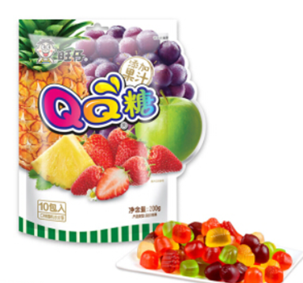
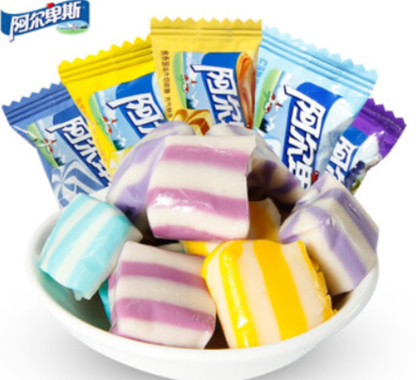
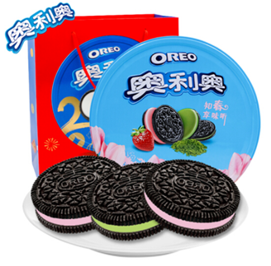
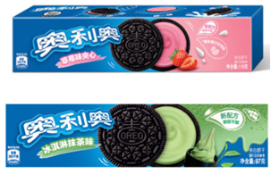
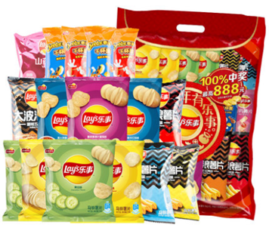
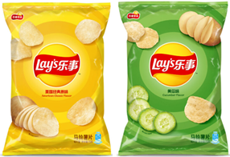
Price/Pack
Assortment
Rural Emergence
Demand Shifts
UTILIZE EMERGING SEGMENTS FOR GROWTH
Gummy Candy and Snacks Gifting can source your growth
Value Share +/- vs LY | NAT
Rising Gummy/Jelly Candy Segment
Snacks Successful Gifting Packs
Top performers
Gifting Package
Hero SKU
Oreo Classic 116g
Plain / Chocolate / Strawberry
Gifting Package
Hero SKU
Lay’s NPC 70g
Original / Cucumber / Tomato Chicken
Data source: Nielsen RMS data, Data ending Sep’20

Slide 26
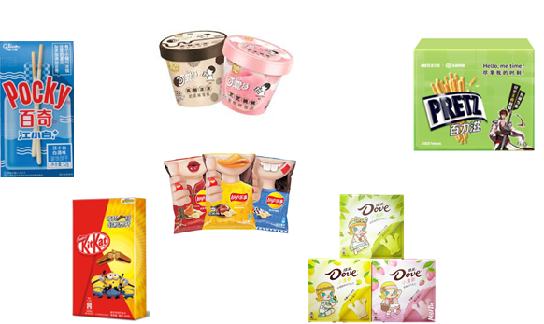

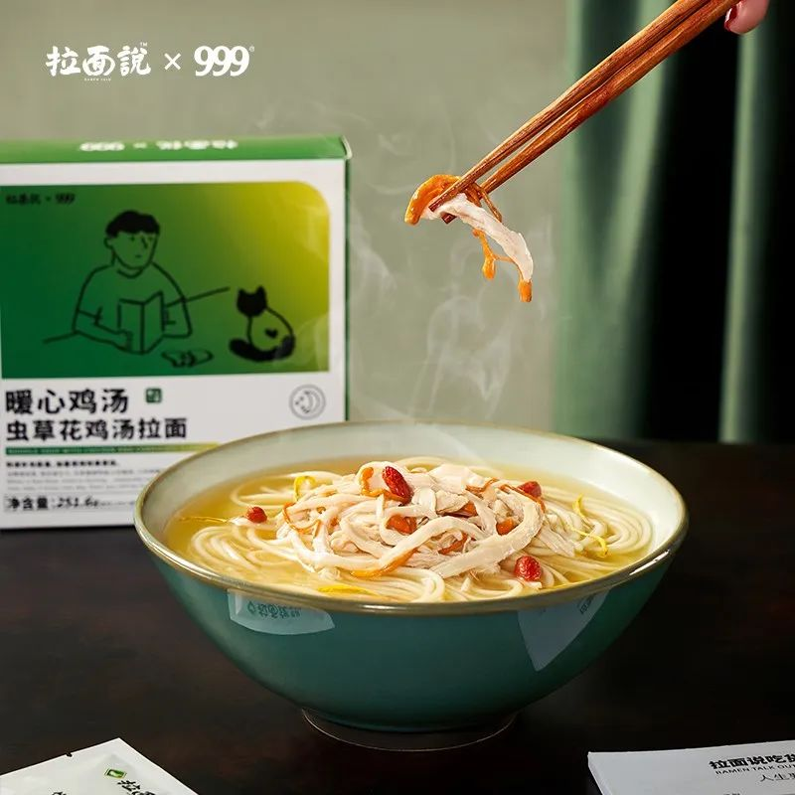

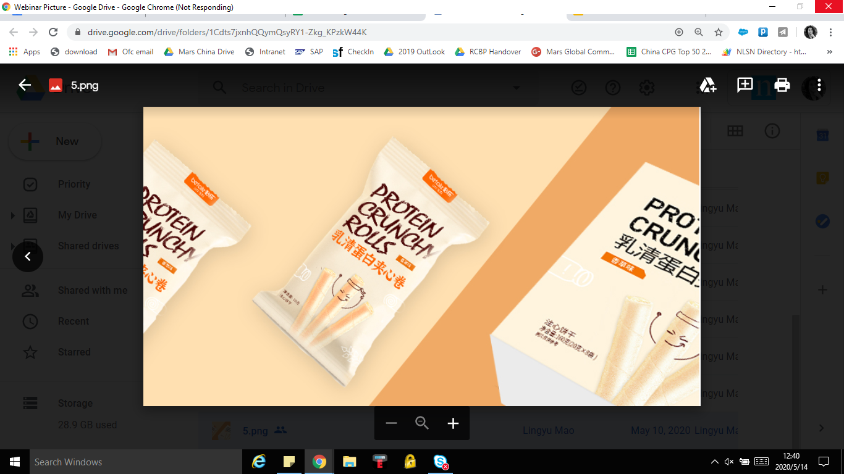

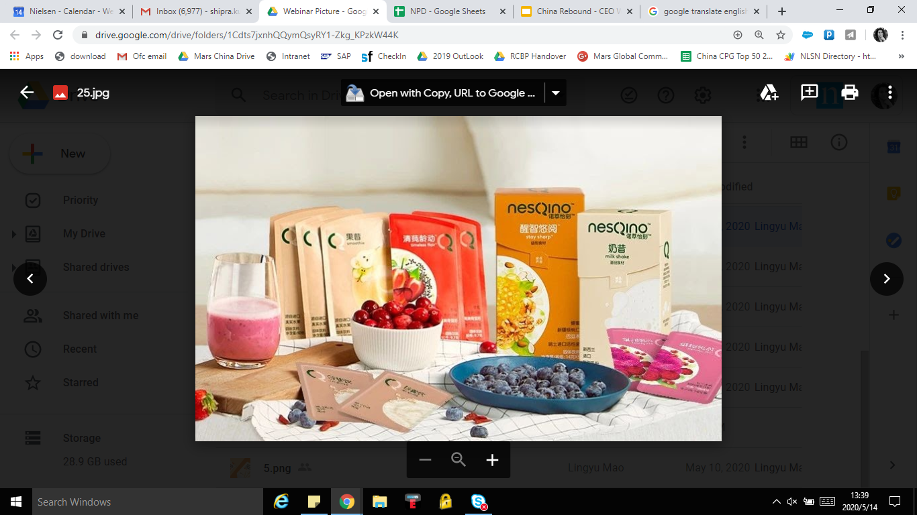

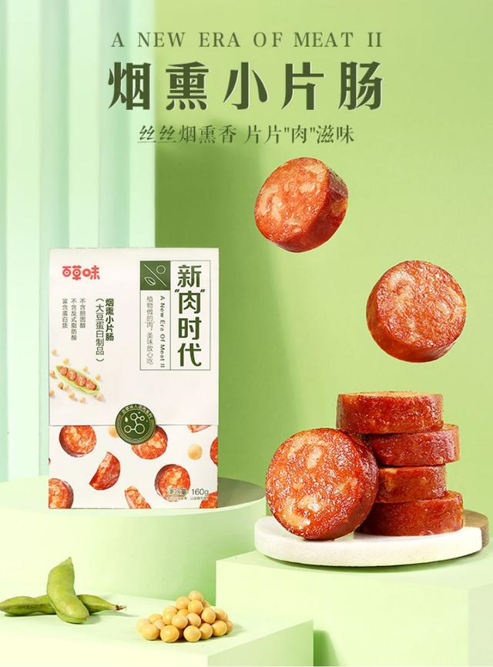

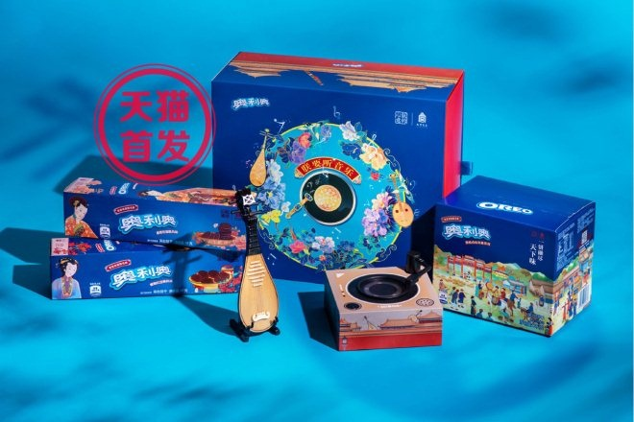
Price/Pack
Assortment
Rural Emergence
Demand Shifts
TACKLE NEW TRENDS WHITESPACE
High potential of Rural areas for consumption
Reach out to your target audience through IP/Other Brands
New trends among adjacent categories still untapped in Snacks industry
EMOTIONAL WELLBEING
Better sleep, anti-anxiety, family / community bond
HEALTH & WELLNESS
Immunity, vitality, Nutrition, Energy, Natural, Organic
Coca-Cola Wuhan Edition
Ramen in the package of 999 Cold Killer medicine
Calming walnut drink for immunity
Bile Protein
Crunch Roll Biscuits
MEAL REPLACEMENTS
In Home, DIY, Convenient, On the Go, Healthy
EMERGING FOODS
Healthy / Natural / Sustainable
76+ MILLION VIEWS | 31K DISCUSSION THREADS
First launch on 2019. 6.18
In one day:
760K units
NesQino Meal replacement drink
Yoplait Mixed Nut Yogurt
Smokey Sausages - Mock Meat Snack
Bright "Morning"
rice milk beverage
260K+ New Memberships
Data source: Nielsen RMS data, Data ending Sep’20, JD.com

Slide 27
EXECUTIVE SUMMARY
Business Question: What are the opportunities for Mars to grow in YTD 2021?
Focus on existing economic packs
Leverage adjacent categories for more economic alternatives
Promote products especially in larger cities’ MT
PRICE/PACK MIX
ASSORTMENT SHIFTS
Sharpen Urban assortment and push distribution of hero SKUs to gain ~670 Mn RMB in YTD 2109
Push promising NPDs in MT to gain 61 Mn RMB in YTD 2109
RURAL EMERGENCE
Optimize Rural assortment in to gain ~1.1 Bn RMB in YTD 2109
DEMAND
SHIFTS
Revive gifting using Hero SKU + Gifting package strategy
Use IP or other brand cooperation to drive consumer pull
Tackle new consumer trends utilized by adjacent categories yet still untapped in Snacks

Slide 28
Thank You

Slide 29
Appendix

